Slide 1

Emirates Support Natural Language Processing Project
Abbas Qureshi

Slide 2
The Flying Issue
One of the most prominent if not the most popular airline globally is Emirates Airlines. Promising the best in class service to all of its passengers and an unmatched service transiting through its Dubai International Airport, Emirates has managed to win a multitude of Airline of the Year Awards in many categories. Currently Emirates operates over 3,600 flights a week from its hub in Dubai, with over 150 cities and 80 countries across 6 continents. Its two main competitors are also located in the Middle East, Qatar Airways and Etihad Airways. Together these airlines are known as the big three, each of them competing to provide stellar services from suite based business class seats to entire apartments available to book. With such stiff competition from each other, it is paramount that these airlines will have to work very carefully to address all issues that passengers face and optimize their experience to reduce error found in any of the stations around the world or in any of the flights around the world.

Slide 3
The Project
The project I have decided to do for my second capstone is to investigate the issues that passengers face during the entire travel experience, from booking, checking in, inflight, and arrival. One of the best ways to get this information will be through Twitter. Twitter is not only a great social media platform to share your thoughts and ideas, but from a business point of view it is also an excellent ‘focus group’ platform that can help businesses understand the thoughts and sentiments of their customers and clients. The aviation world is such that not many people enjoy travelling to begin with, you may be lacking sleep, flight delays, cancellations, long flights leading to exhaustion, all of these factors accumulate into very frustrated passengers who may then encounter a glitch in the airline system or a mistake by a flight attendant or ticketing agent. These experiences can result to passengers taking out their phones and venting their frustration on twitter, sometimes with photo or video evidence.

Slide 4
The Strategy
My plan of action was to first collect the data and create a database, clean the data, wrangle the data, perform a brief exploratory data analysis on it since there is not much exploratory analysis that can be done on text data, apply a sentiment analysis on it to determine whether a tweet is negative, positive, or neutral. Lastly, I wanted to flex my machine learning muscles and apply some classification algorithms to determine whether the tweet would be positive or negative. These algorithms would be Naïve Bayes Gaussian, Logistic Regression, and Random Forest.

Slide 5
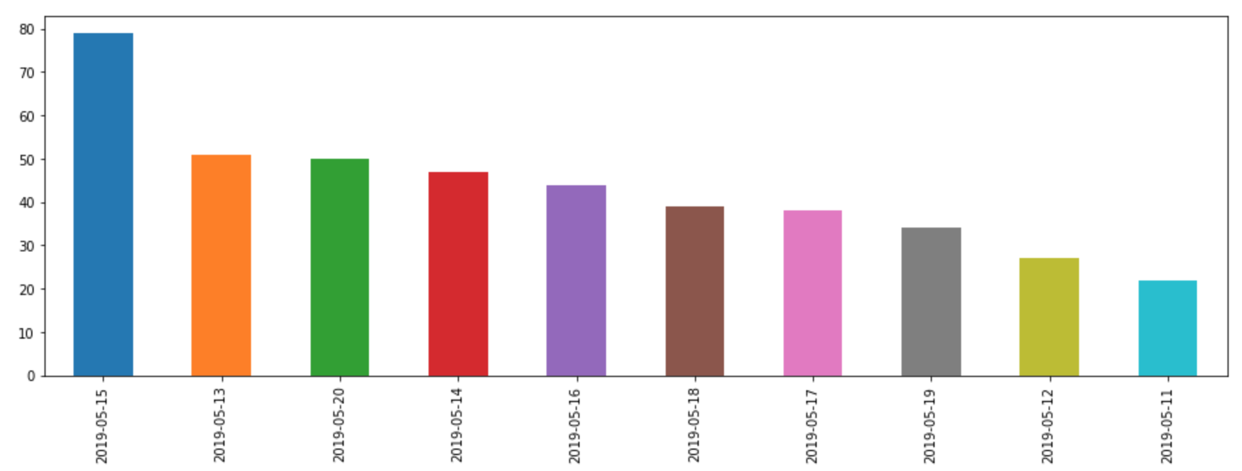
Upon getting the tweets, I wanted to analyze whether there was a distinction with dates and the tweets. There was a spike in tweets on May 15th, 2019, which is a Wednesday. I checked online whether there were any special events happening that day and nothing came up. We can assume since there is a higher rate of passengers on a Wednesday due to cheaper flights we have more tweets that day.

Slide 6
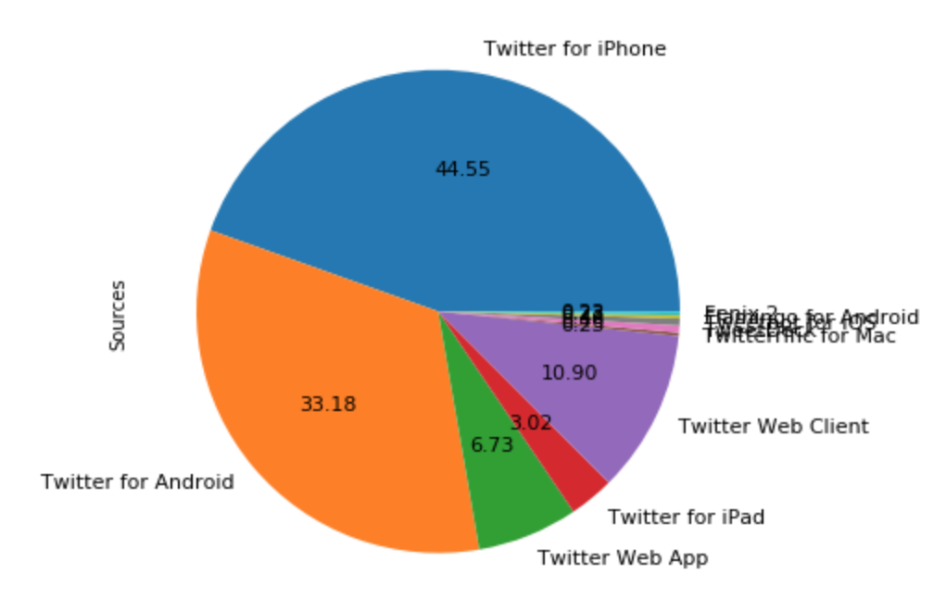
Next I wanted to have a look at the sources of the tweets to see if they were done on mobile phones or on a computer. This could give a hint whether these tweets were written on the spot in anger or in joy or on a computer after the passenger dealt with the entire experience first. The results showed iPhone sitting at 44.5% and Android at 33% taking the most claim with 10% going to web clients.

Slide 7
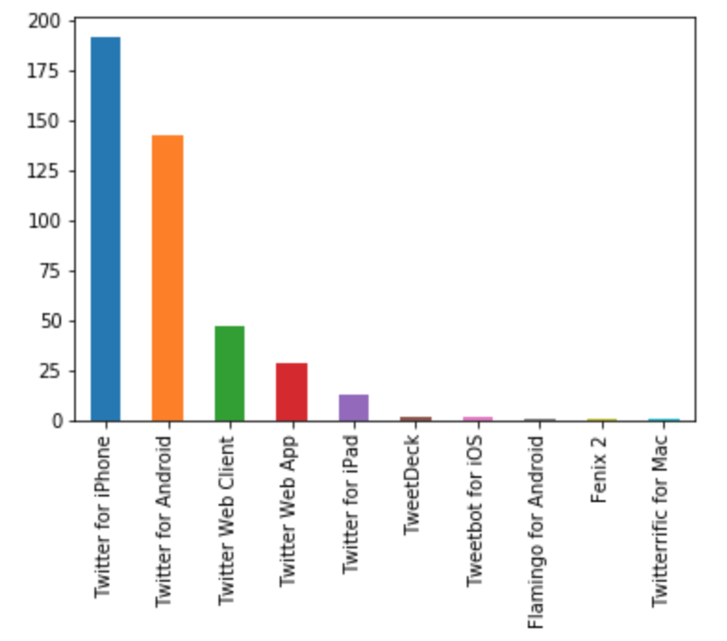
Here is another bar graph showing the count of the sources. Twitter for iPhone going just shy of 200 while Android just below 150. The next in line was web client sitting just below 50.

Slide 8
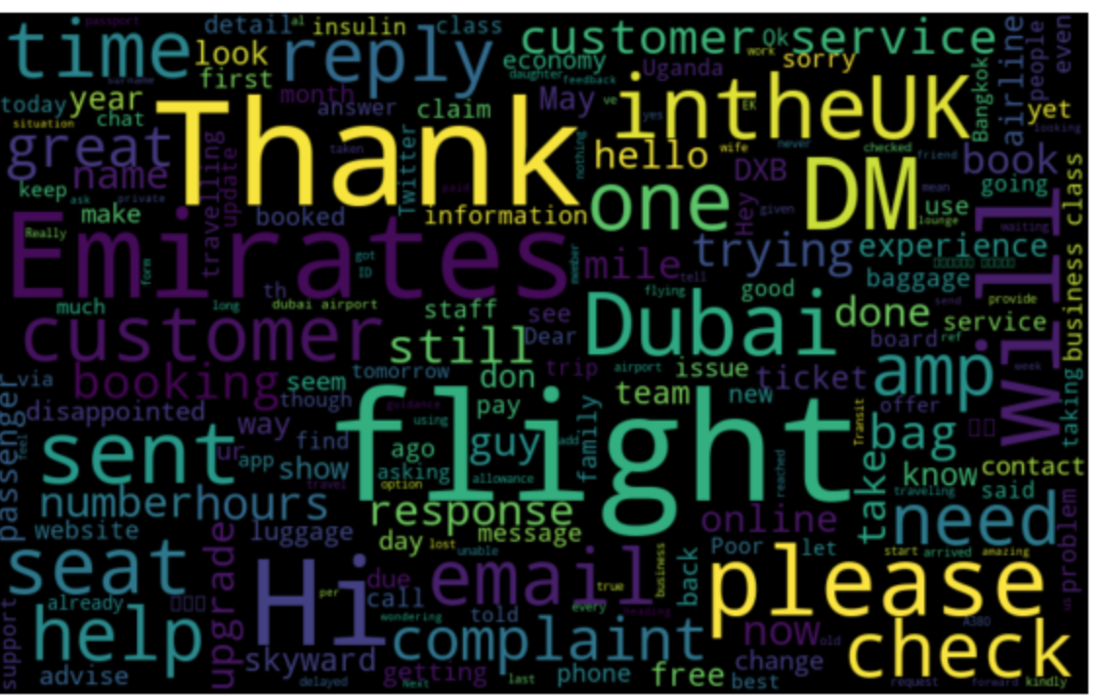
Here is a general word cloud before running any sentiment analysis, these are all tweets positive or negative or neutral. The expectations are pretty standard, with Thank, flight, Dubai, please check, are the common words found. Lets dive further into this with positive and negative tweets.

Slide 9
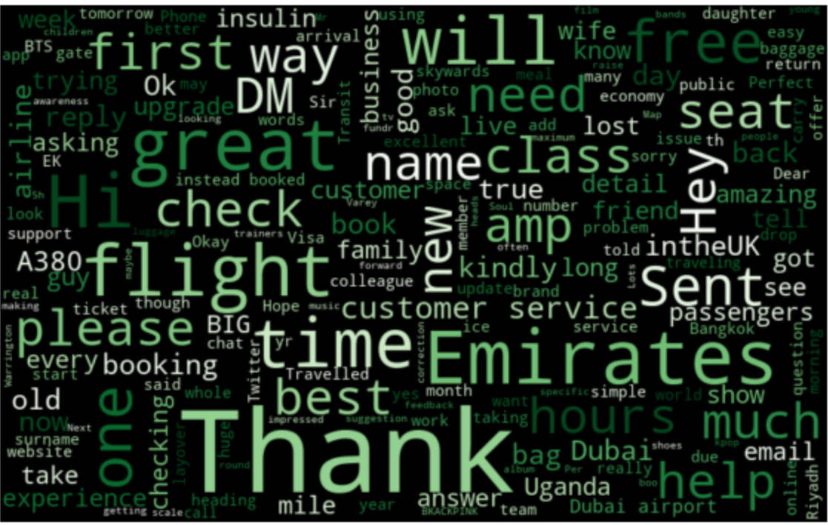
Here is the word cloud for positive tweets. The highest counts go to Thank, great, flight, Emirates, help free. These are expected as these would be considered positive words coming from passengers with a positive experience.

Slide 10
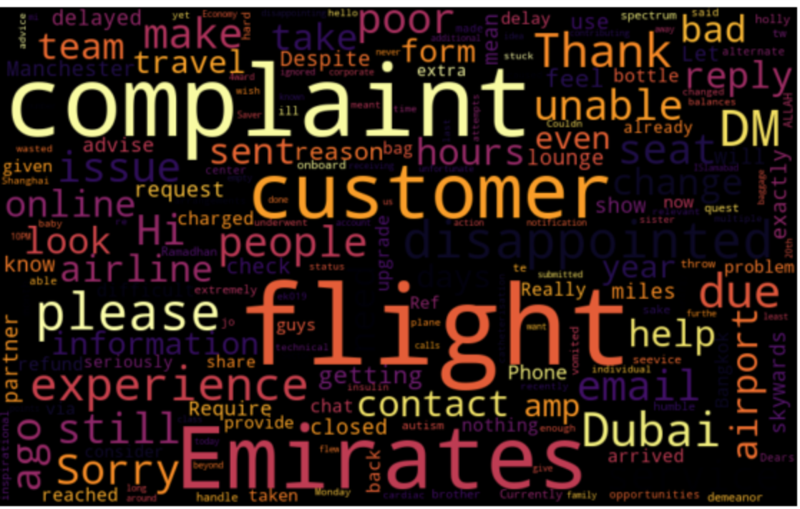
Here is the word cloud for negative tweets. They comprise of words such as complaint, customer, service, experience, unable, airport, travel, flight. These could indicate the customer service was lacking and the experience overall had not been good, coming from the flight to even the airport.

Slide 11

Machine Learning Results
The machine learning algorithms applied were Logistic Regression, Random Forest, and Gaussian Naïve Bayes. The scores were as follows:
Logistic Regression: 66%
Random Forest: 52%
Naïve Bayes before tweaking VADER: 49%
Naïve Bayes after tweaking VADER: 58%

